Slide 1
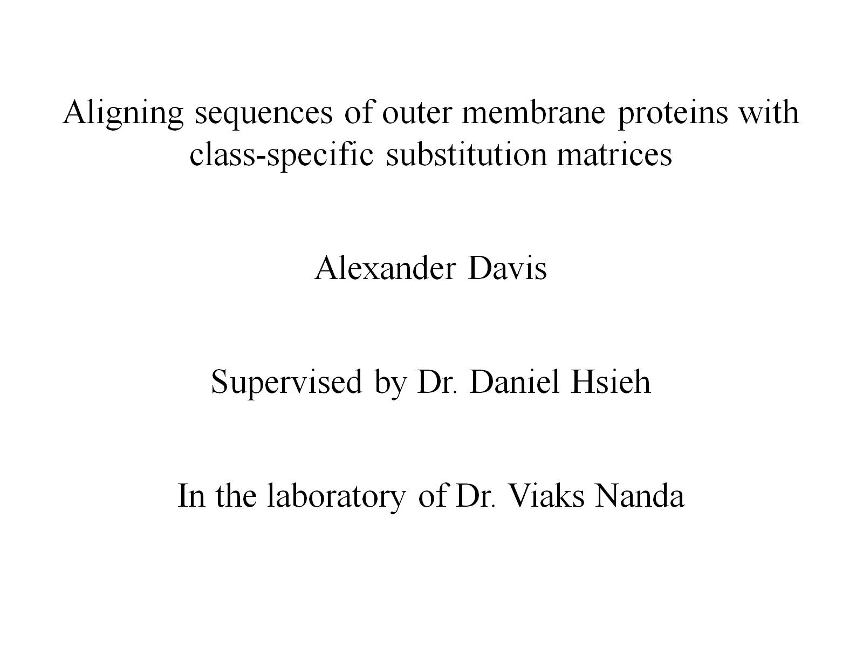

Slide 2
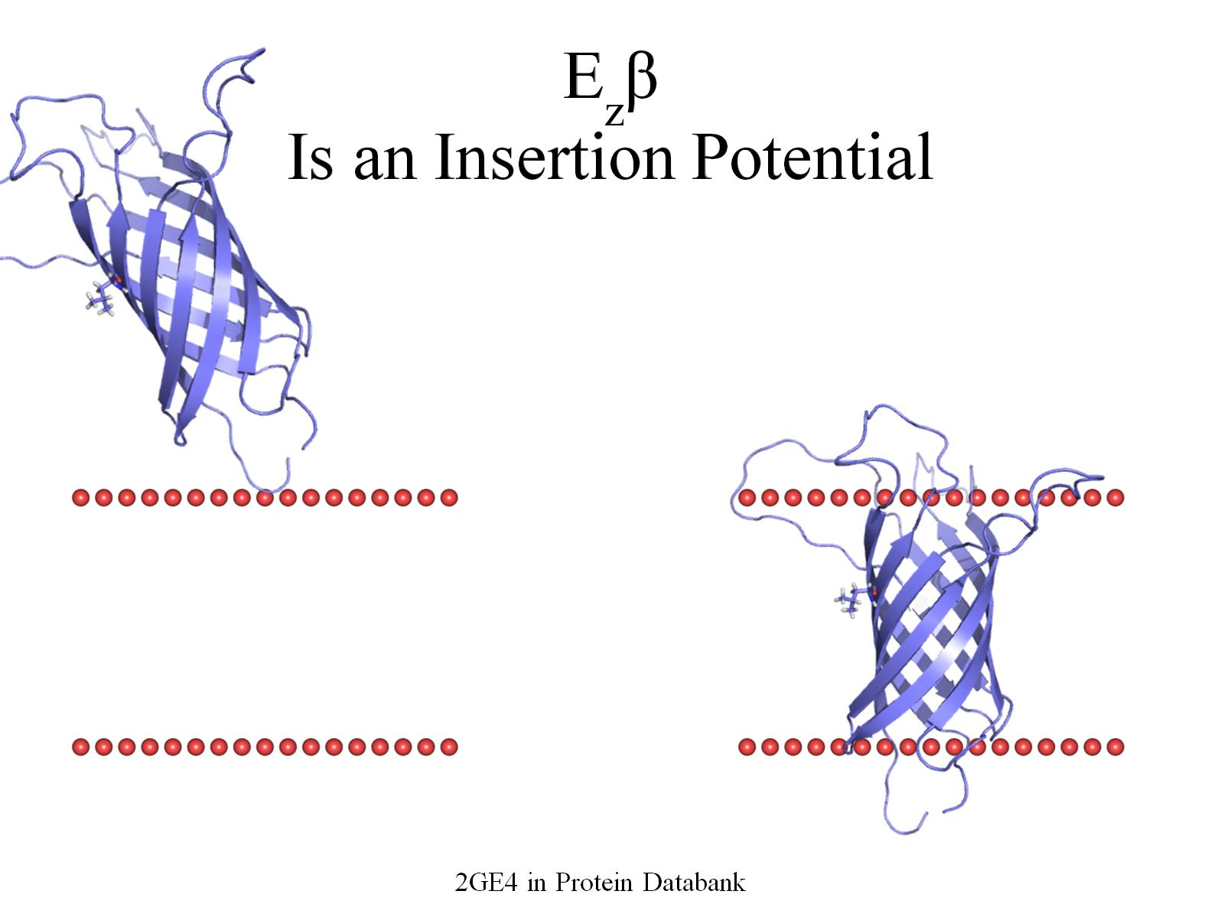
E_{z}β Is an Insertion Potential

Slide 3
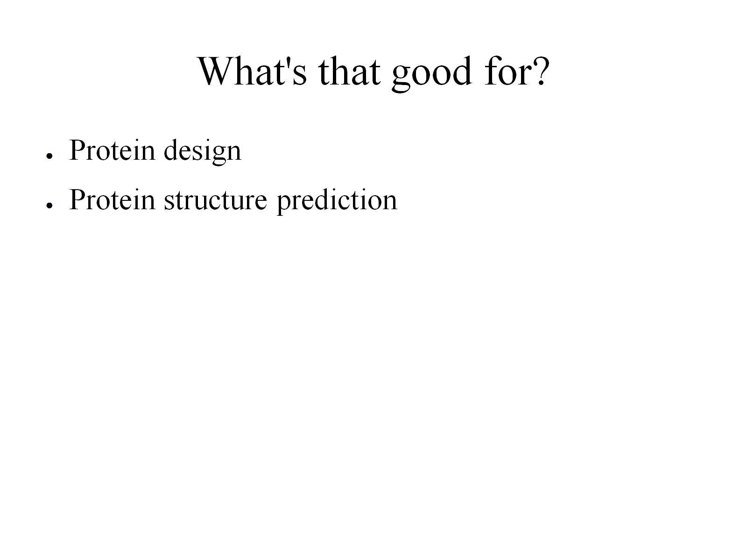
What's that good for?

Slide 4
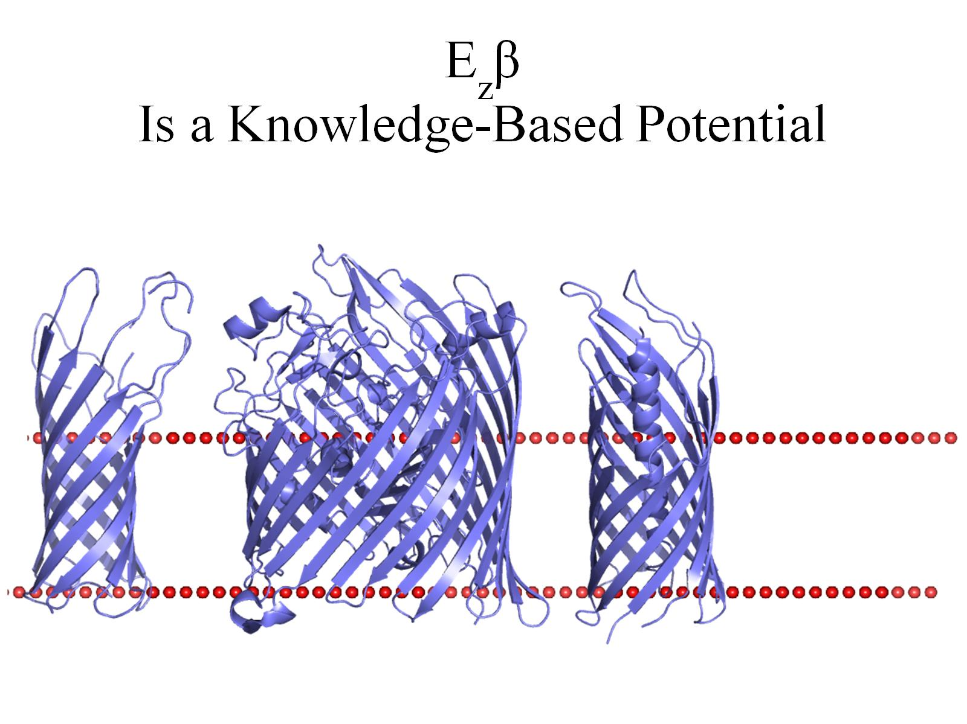
E_{z}β Is a Knowledge-Based Potential

Slide 5
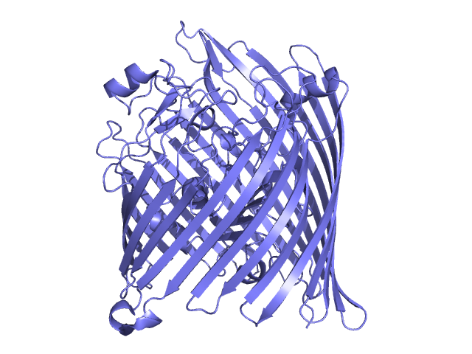
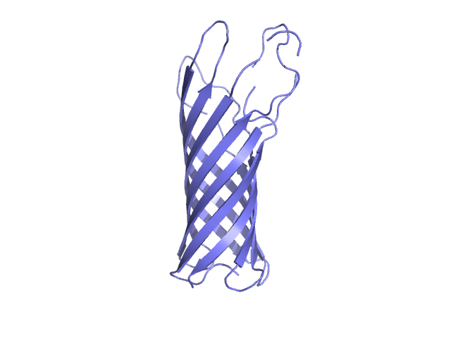
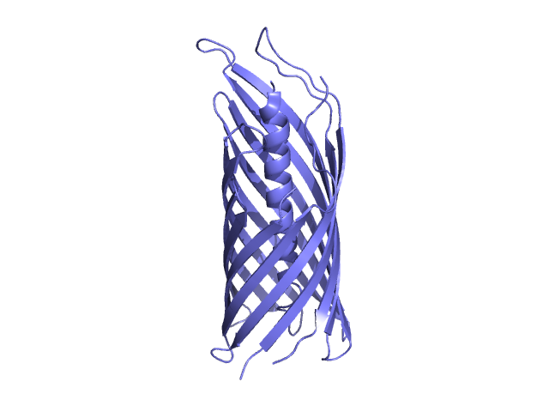
E_{z}β Is a Knowledge-Based Potential
~6% Alanine
~10% Alanine

Slide 6
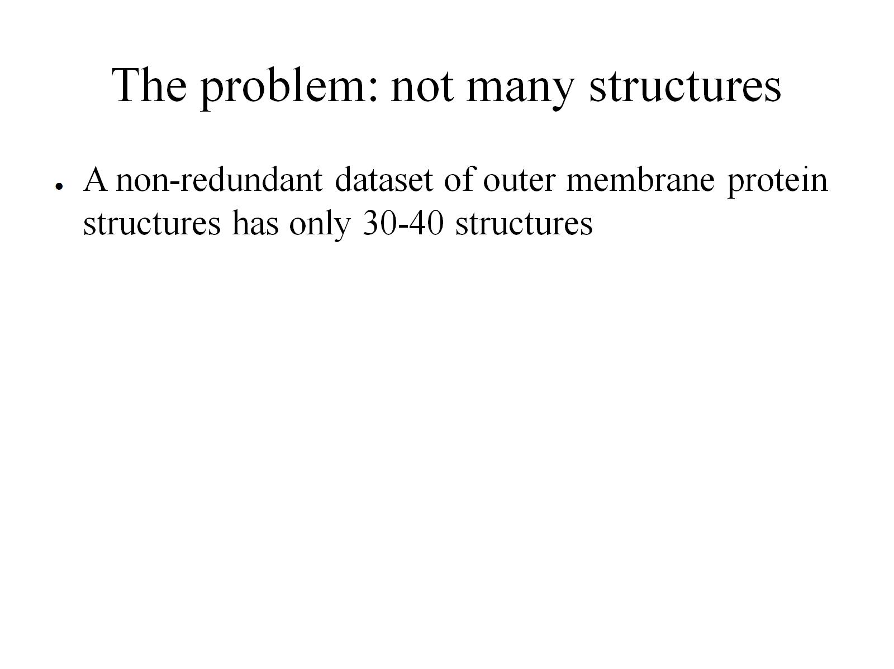
The problem: not many structures

Slide 7
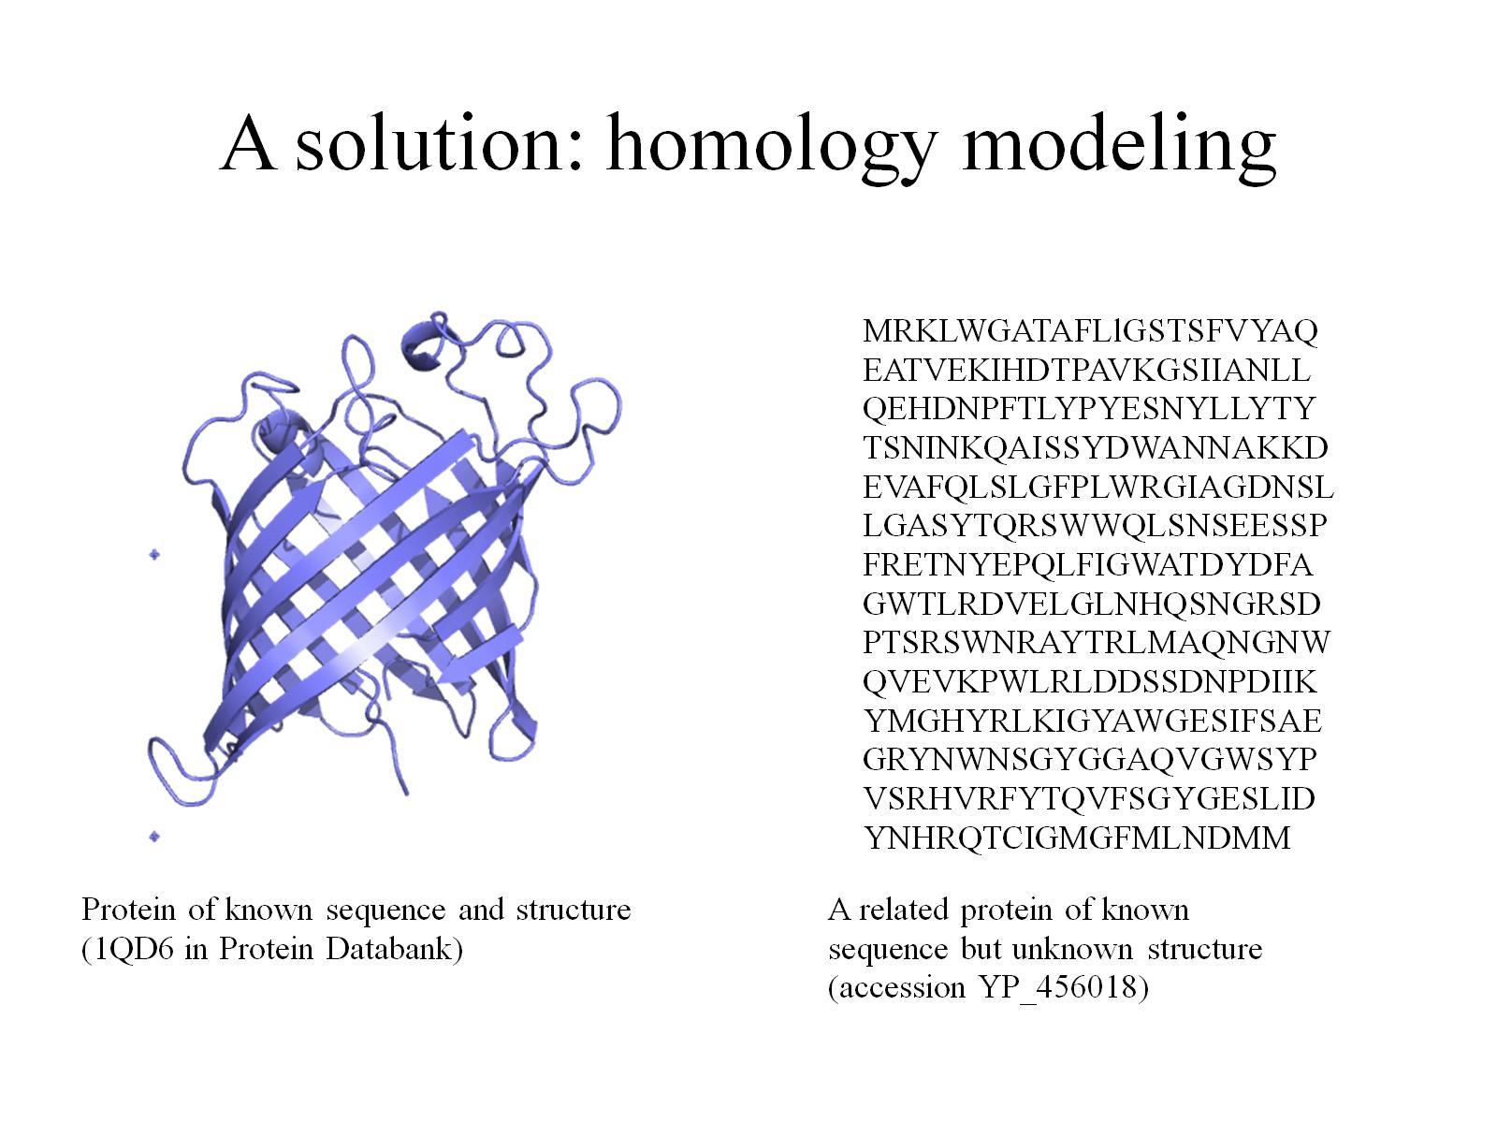
A solution: homology modeling

Slide 8
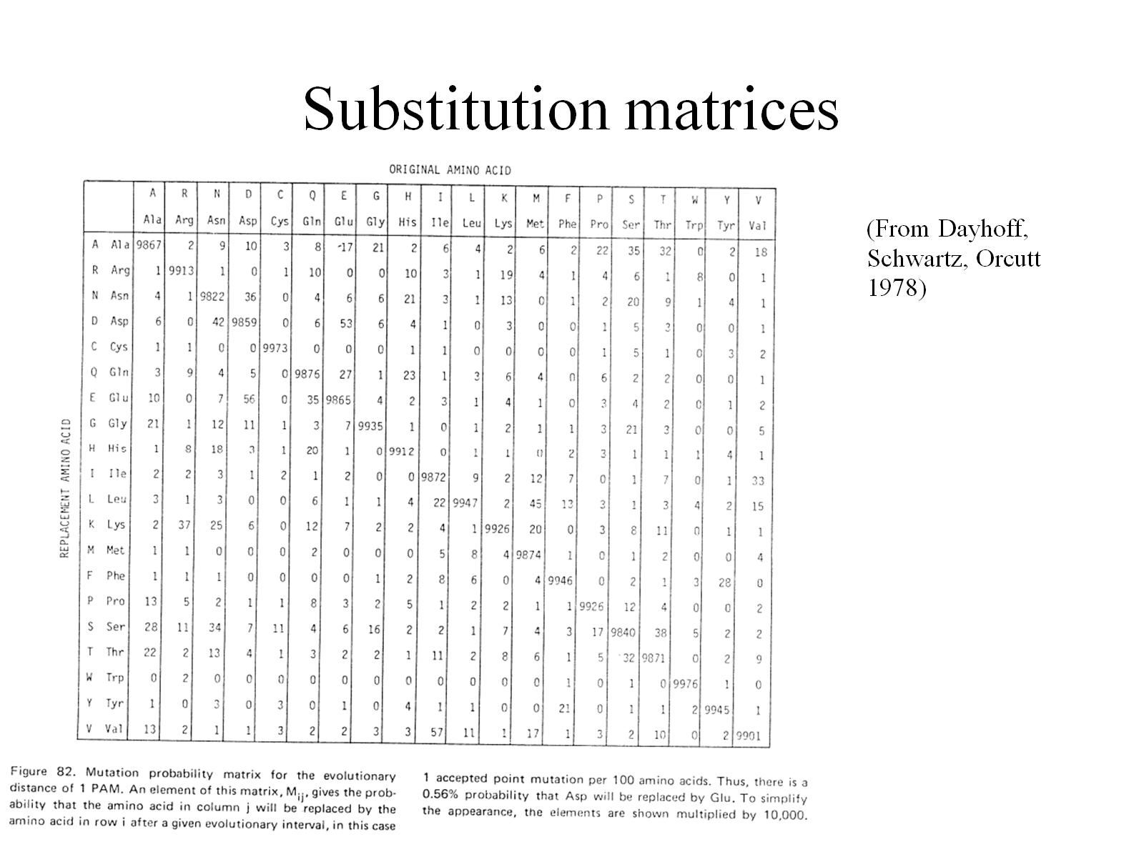
Substitution matrices

Slide 9
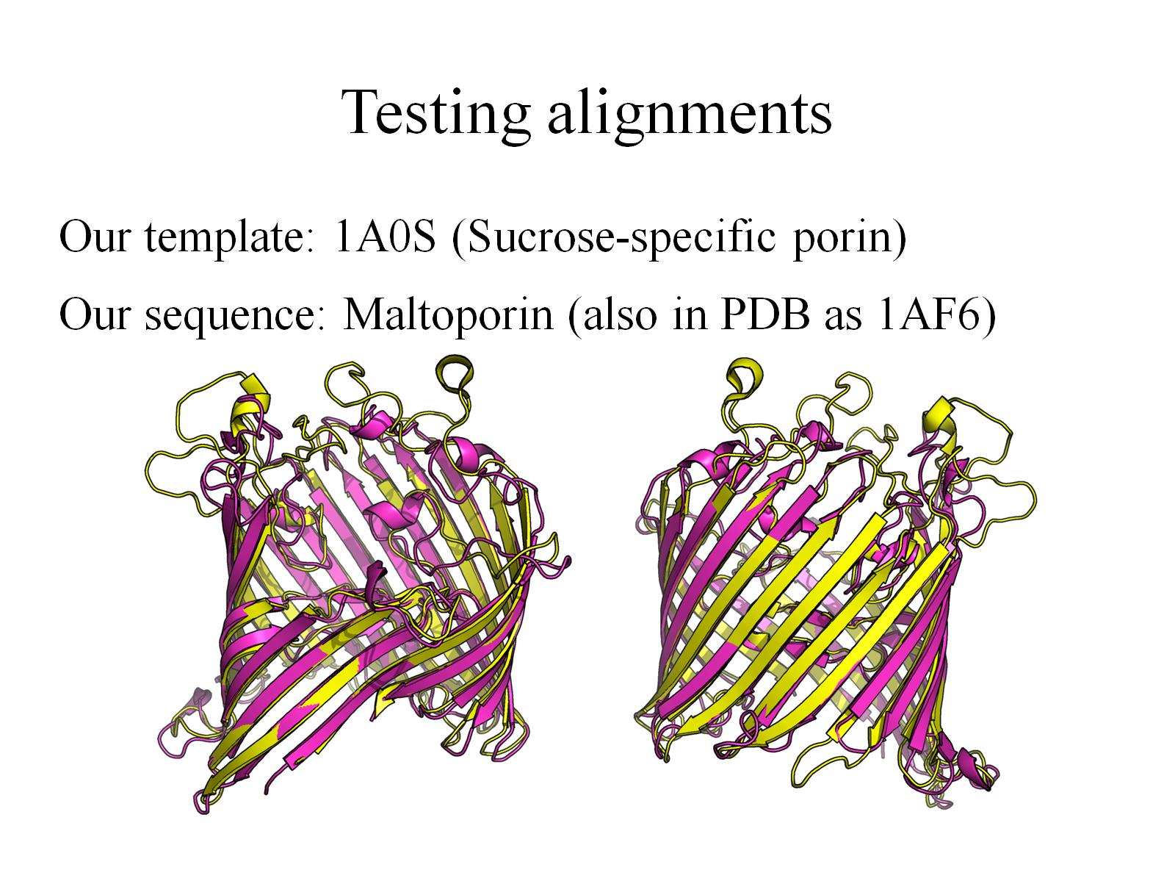
Testing alignments

Slide 10
Comparing alignments
Control: align residues that are close together in the aligned structures.
Gonnet series of matrices
Derived from substitution rates in soluble proteins
BBTMOUT matrix
Derived from substitution rates in outer membrane proteins

Slide 11

Predicted structure of maltoporin, with 1A0S as a template: optimal alignment

Slide 12
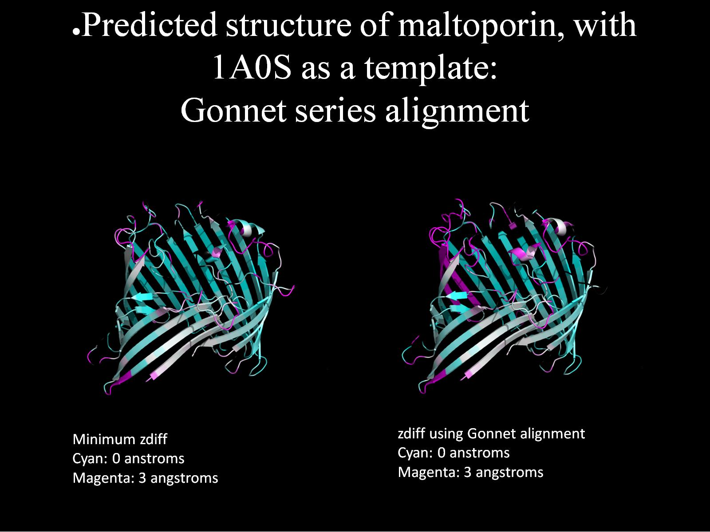
Predicted structure of maltoporin, with 1A0S as a template: Gonnet series alignment

Slide 13
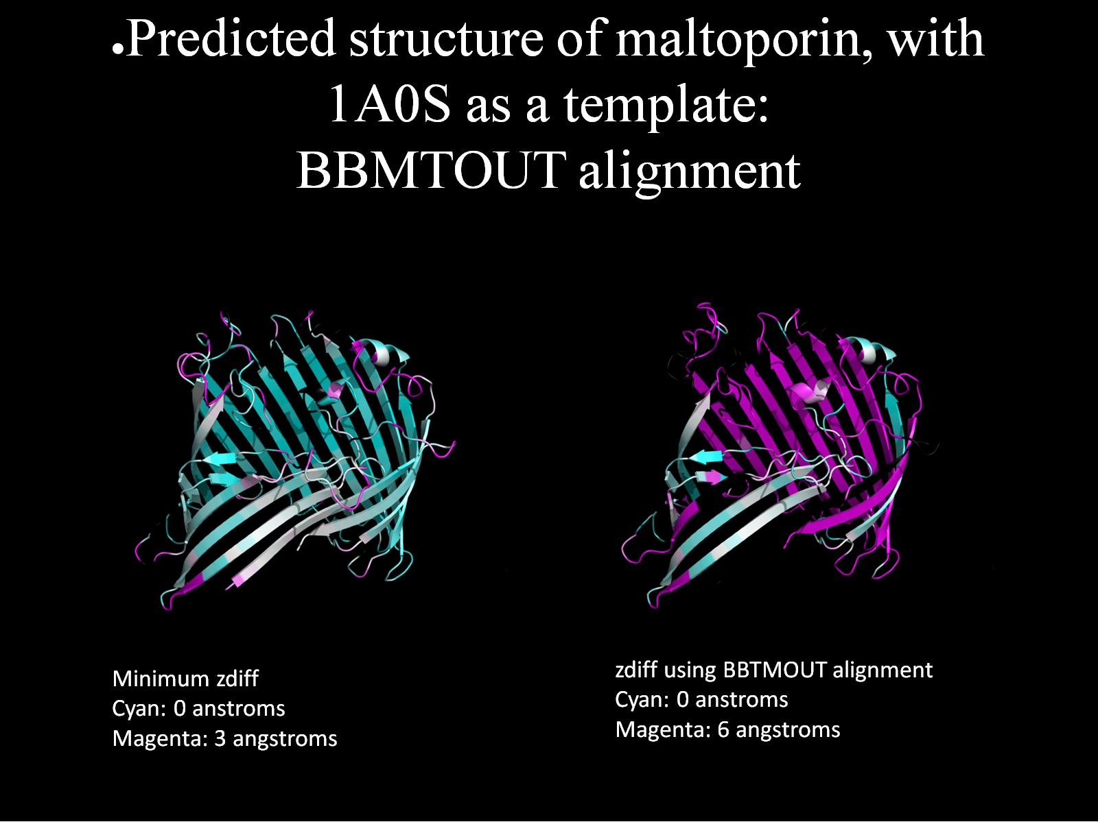
Predicted structure of maltoporin, with 1A0S as a template: BBMTOUT alignment

Slide 14
Current work
Learn enough about continuous Markov chains to understand the paper reporting BBTMOUT and derive a series

